Slide 1

Developing Data Health & Maturity With Open-Source Technologies
Frederic Randall
Data Manager & IT Specialist

Slide 2
Overview
The State of Data in the Nonprofit World
MND & Me
Defining Data Health
Developing Data Maturity
Establishing Data Culture & Literacy
Open-Source Tools

Slide 3
The State of Data in the Nonprofit World

Slide 4
Target Analytics
3%
$3.7
74%
of nonprofits use any form of advanced analytics
of constituent email addresses missing at average nonprofit
million on average in untapped giving potential

Slide 5
Software Surveys
Surveys from software companies like EveryAction and Salesforce suggest that even more technologically capable NPO’s struggle to effectively utilize the data that they collect .

Slide 6
EveryAction

Slide 7
Nonprofit Trends Report Salesforce

Slide 8
Reflection

Slide 9
SQL (Sequel)

Slide 10
Structured Query Language

Slide 11

Python

Slide 12
Resources

Slide 13

Resources

Slide 14

Resources

Slide 15

Resources

Slide 16

Resources

Slide 17

Resources

Slide 18
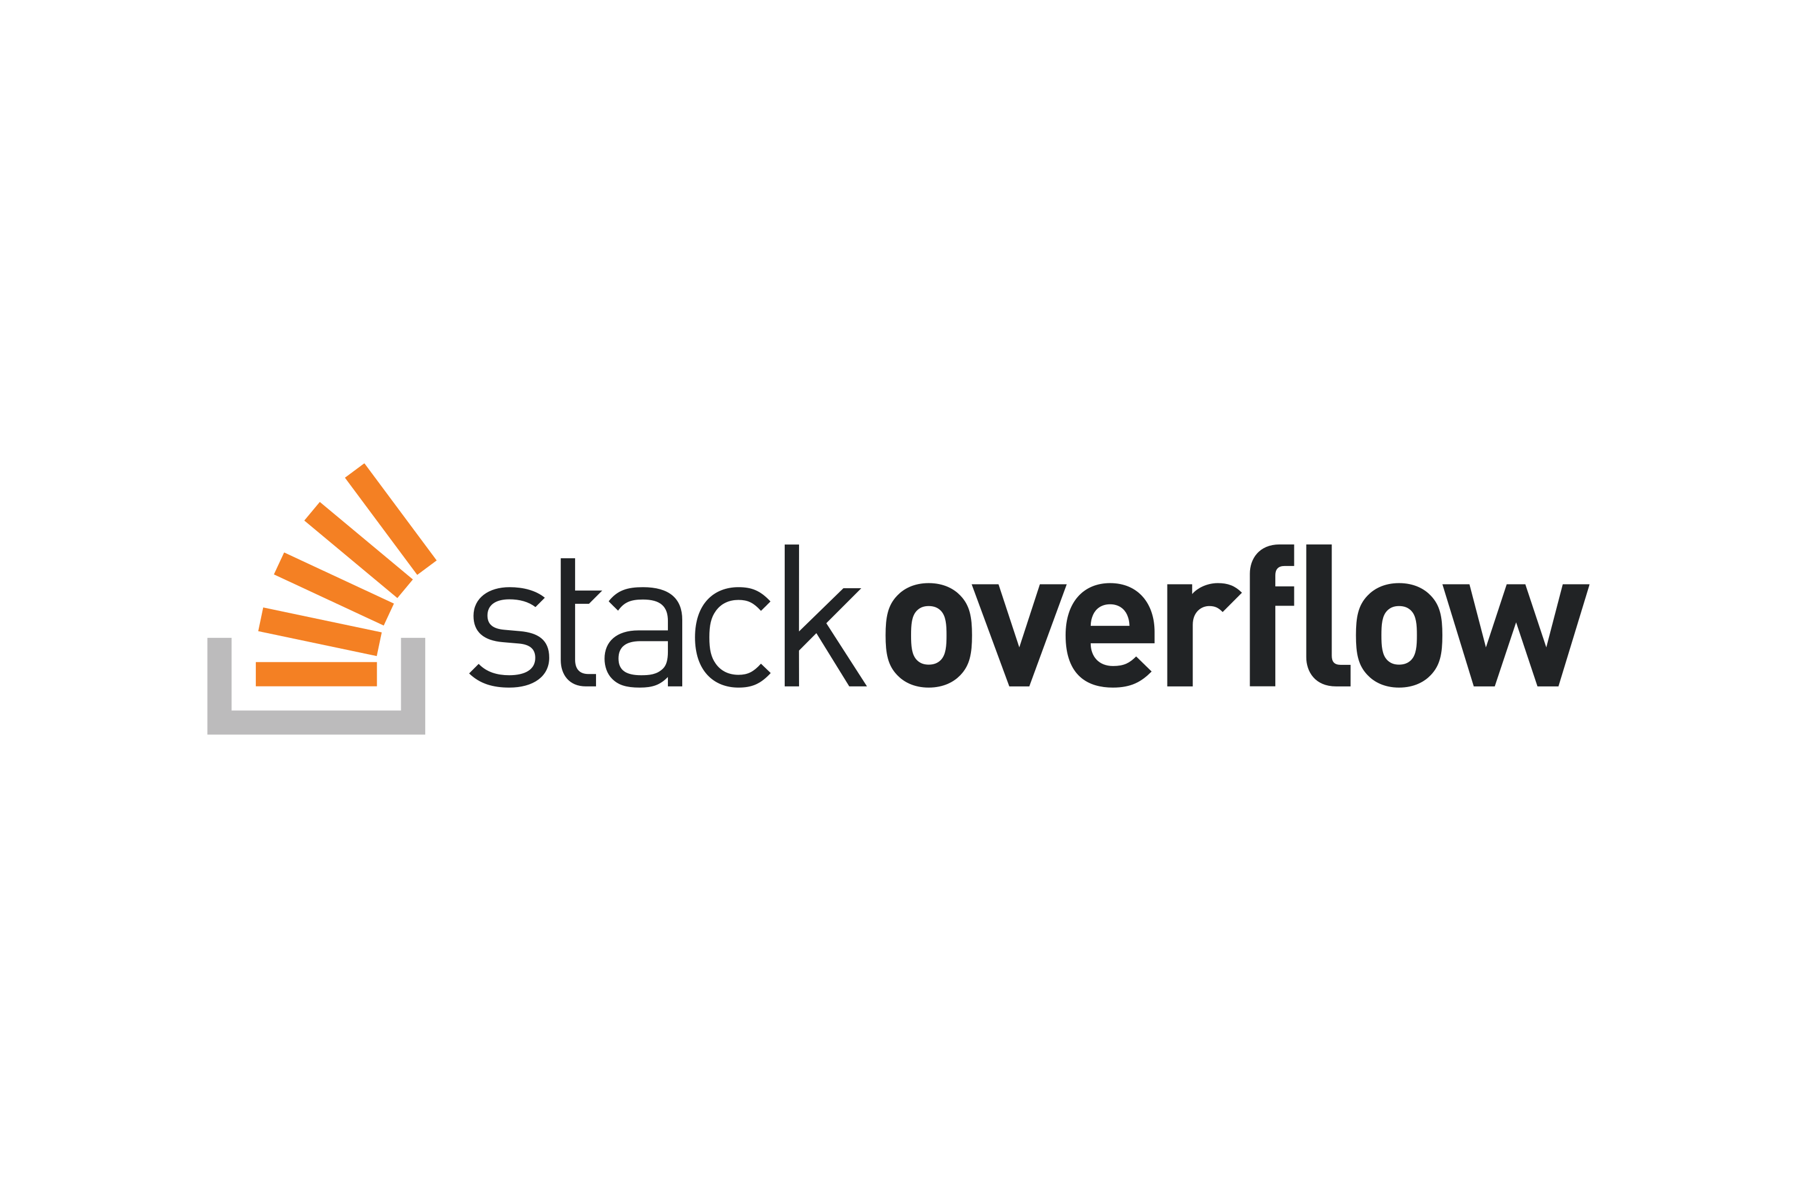
Resources

Slide 19

Resources

Slide 20

Resources

Slide 21

Resources

Slide 22
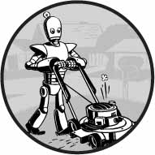
Resources

Slide 23

Resources

Slide 24

Resources

Slide 25

Resources

Slide 26
Fractured Data Infrastructure

Slide 27

Fractured Data Infrastructure

Slide 28

Fractured Data Infrastructure

Slide 29

Fractured Data Infrastructure

Slide 30

Fractured Data Infrastructure

Slide 31

Fractured Data Infrastructure

Slide 32
One Year Later …

Slide 33
Driving Change
Consolidating Data
Implementing Standards of Operation
Integrating the value of data in the organizational culture
Utilizing Open-Source Tools

Slide 34
Defining Data Health

Slide 35
Maintaining Healthy Data
Preventative Care
Effective Treatments
Supportive Culture

Slide 36
Measuring Data Health
Accuracy
Completeness
Consistency
Timeliness
Uniqueness
Conformity

Slide 37
Data Maturity Scale

Slide 38
Data Maturity Scale
Baseline
Descriptive Analytics
Diagnostic Analytics
Predictive Analytics
Prescriptive Analytics

Slide 39
Baseline
Level One

Slide 40
Descriptive Analytics
Level Two

Slide 41
Diagnostic Analytics
Level Three

Slide 42
Predictive Analytics
Level Four

Slide 43
Prescriptive Analytics
Level Five

Slide 44
Data Maturity Scale
1. Baseline
2. Descriptive Analytics
3. Diagnostic Analytics
4. Predictive Analytics
5. Prescriptive Analytics

Slide 45
Establishing Data Culture and Literacy

Slide 46
First Steps
Eliminate Rogue Data
Promote Organizational Engagement
Develop An Introductory Project

Slide 47
The Components of Culture
Purpose
Values
Behaviors
Recognition
Rituals
Cues

Slide 48
Formula for Change
C = (D*V*F)>R

Slide 49
Formula for Change
C = (D*V*F)>R
Change occurs when the product of Dissatisfaction, First Steps, and Vision is greater than Resistance.

Slide 50
Promoting Cultural Change
Acknowledge Strength
Baby Steps
Align Culture & Strategy

Slide 51
Culture Models
Agile Culture
Lean Methodology

Slide 52
Data Literacy
Volume
Variety
Velocity
Veracity
=
Value

Slide 53
Open-Source Tools

Slide 54
SQL

Slide 55

SQL

Slide 56

SQL

Slide 57

SQL

Slide 58
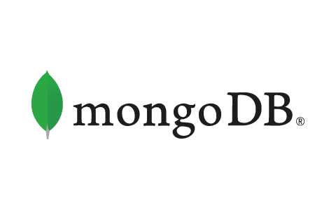
SQL

Slide 59

SQL

Slide 60

SQL

Slide 61
Python
Notes:
“

Slide 62

Python

Slide 63

Python

Slide 64

Python

Slide 65

Python

Slide 66

Python

Slide 67
Python

Slide 68

Python

Slide 69

Python

Slide 70

Python

Slide 71

Python

Slide 72
Open-Source Tools

Slide 73




Open-Source Tools

Slide 74
Conclusion

Slide 75
Developing Data Health & Maturity With Open-Source Technologies
Frederic Randall
Data Manager & IT Specialist

